Slide 1
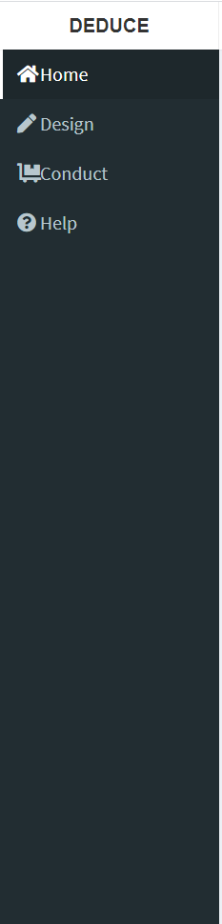

Remove “?” button as it is redundant with left panel
Change “Design” to “Trial Design”
Trial Design
Change “Conduct” to “Trial Conduct”
Trial Conduct
[Use this layout and DEDUCE logo but replace
One child photo with one adult/senior photo]
“Help” button links to PDF documentation only
About
Add “About” tab
Add icon
[Suggested revised text]
The DEDUCE platform – a unified resource for clinical investigators and statisticians to design and conduct safer, more efficient, and more accurate phase 1 trials.
Overview
The DEsign and conDUCt of dose Escalation trials (DEDUCE) platform is an interactive, web-based resource to design and conduct phase 1 dose escalation trials using rule-based and Bayesian adaptive designs. Our goal in developing this application is to raise awareness, educate, and provide open access to investigators for alternative, improved methods and tools to design and conduct phase 1 dose escalation trials.
DEDUCE Modules:
Trial Design. Users can specify and compare the operating characteristics for hypothetical phase 1 designs through trial simulations, and select an optimal design for the needs of the trial.
Trial Conduct. Users can implement the adaptive trial, and determine the recommended dose level each time a new patient enrolls.
Available Designs:
Continual reassessment method (CRM) [O’Quigley et al. Biometrics, 1990]
TARGETed-agent Continual Reassessment Method (TARGET-CRM)
3+3 [Storer. Biometrics, 1989]
Key Features of DEDUCE:
Permits simultaneous comparison of multiple trial designs for the same set of simulation parameters
Dynamically generates a written report summarizing simulation results
[Add live links to logos]
http://www.danafarberbostonchildrens.org/
[NM team to insert Foundation website]
https://hms.harvard.edu/

Slide 2

About DEDUCE
DEDUCE Leadership: Dana-Farber/Boston Children’s Cancer and Blood Disorders Center
Clement Ma, PhD
Wendy B. London, PhD
Development Team: Northwestern Mutual Life Insurance Company
Ben Garski
Danielle Pankey
Judy Berdan
Stan Crane
Lori Kiraly
Susan Stegman, MD
Nanette Jamel
Laure Borchardt
Audra Brennan
Contact:
For assistance, please contact:
Drs. Clement Ma and Wendy B. London
Citation:
To cite the DEDUCE platform please use:
[Insert citation to published paper]
Acknowledgements:
We would like to thank the Northwestern Mutual “Tech for Good” team for their pro-bono development, design, and project management support for the DEDUCE platform. We would also like to thank our test users, Drs. Steven G. DuBois, Karen D. Wright, and David S. Shulman, for their helpful feedback.
References:
Storer BE. Design and Analysis of Phase I Clinical Trials. Biometrics. 1989;45(3):925-37.
O'Quigley J, Pepe M, Fisher L. Continual reassessment method: a practical design for phase 1 clinical trials in cancer. Biometrics. 1990;46(1):33-48.
Trial Design
Trial Conduct
About
[button to email: DEDUCE.HELP@gmail.com]
Clement to create email address for help
(ADD link: https://pubmed.ncbi.nlm.nih.gov/2790129/)
(ADD link: https://pubmed.ncbi.nlm.nih.gov/2350571/)

